Slide 1
Examples of Patterns
Notes:
Allow students to brainstorm a list of where they see pattern/order in nature/life. The goal here is not to preface the overall goal of looking at patterns/order. The hope is for them to make the connection to God as the activity goes (though guided).
Snowflake, tessellations...couple examples on following slides.

Slide 2
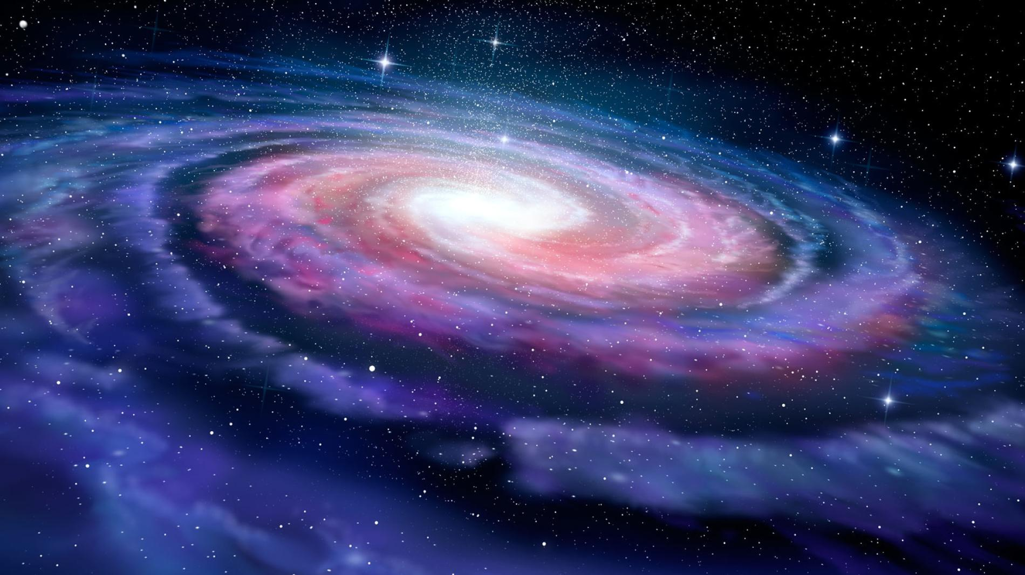
Notes:
Fibonacci sequence

Slide 3
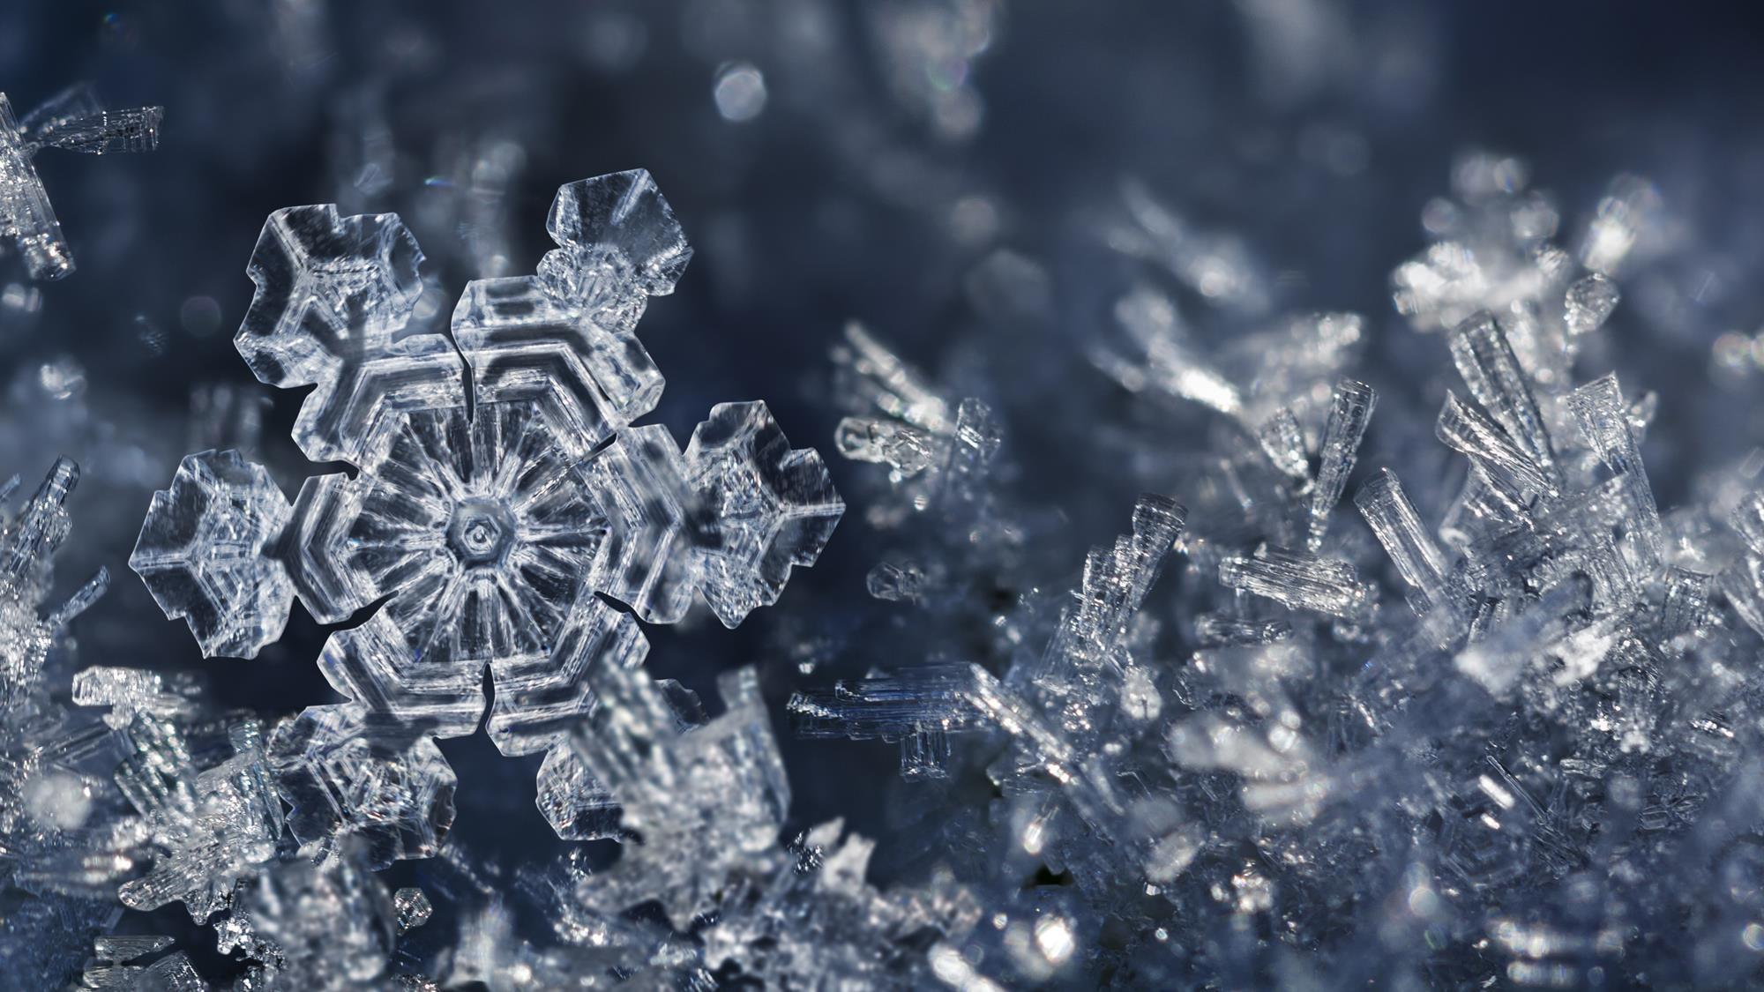

Slide 4
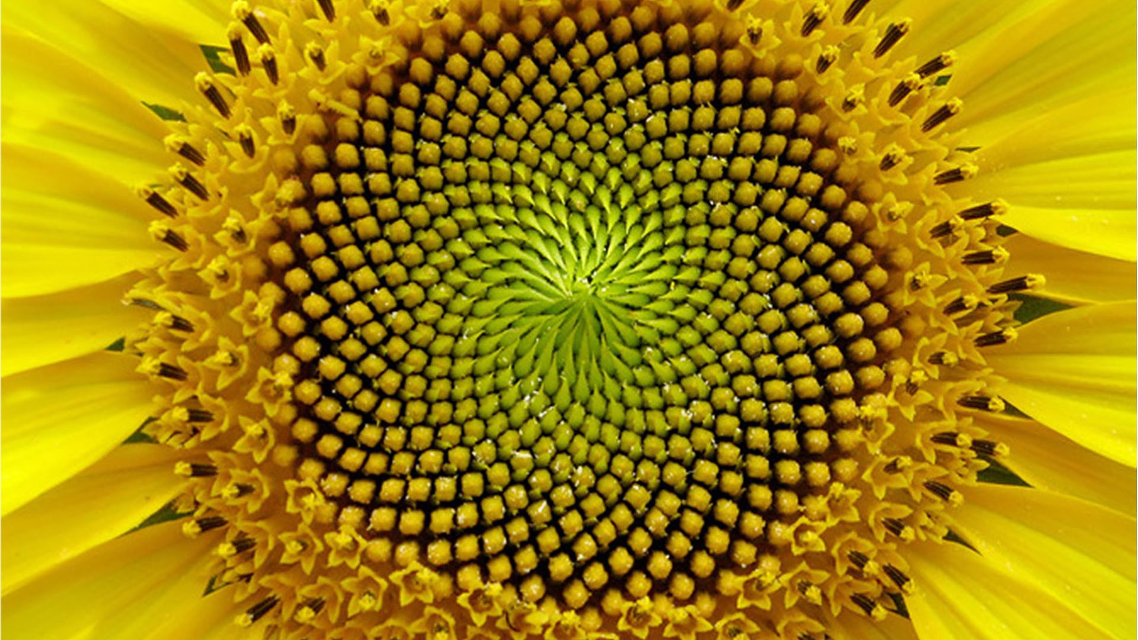
Notes:
Fibonacci sequence

Slide 5
Where do you see pattern or order in chemistry?
Notes:
Use if chemistry examples were not provided in the initial discussion. Allow a couple minutes of brainstorming.

Slide 6
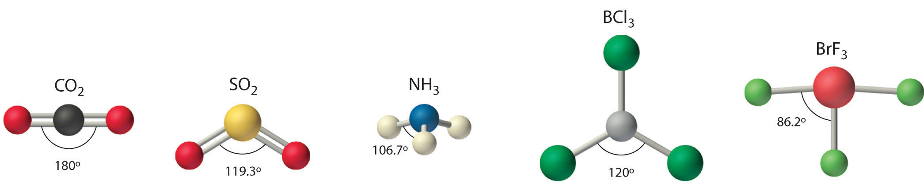
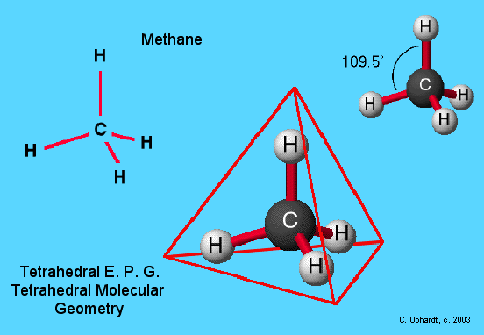
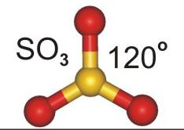

Slide 7
What do the following drawings say about the artist?
Notes:
This slide should be done before discussion questions. Have 3 people (suggestions - an art teacher, a young child, and a student not in one of your chemistry classes) draw a picture. Insert them into this powerpoint on the slides following this one. Have the kids discuss what each drawing says/reveals about its creator. This will prepare them or help guide them in noticing what the order/pattern in nature/chemistry tells us about our great Creator.

